Slide 1
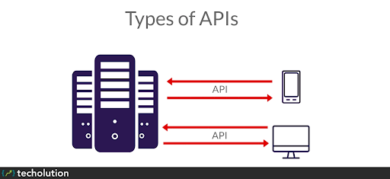
TEAM MEMBERS
p.Ramalakshmi
Supraja mouli
p.Renuka
Niharika
abhishek kumar
S.Anudeep

Slide 2
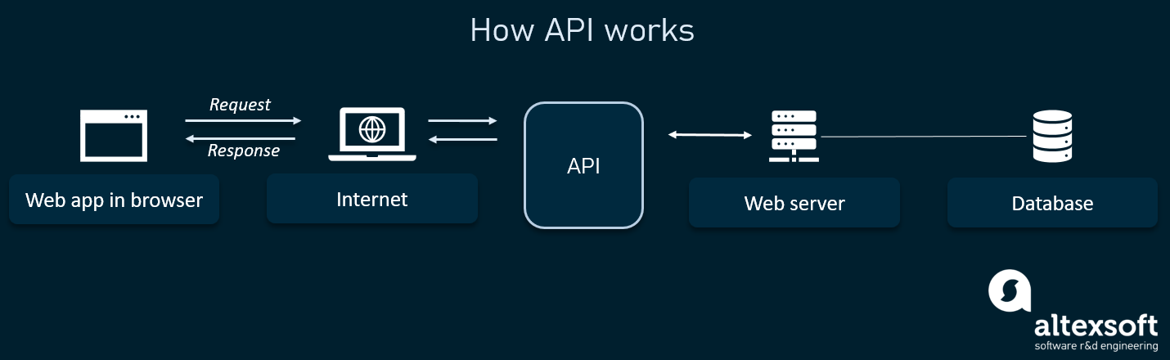
An API (Application Programming Interface) is a set of functions that allows applications to access data and interact with external software components, operating systems, or microservices. To simplify, an API delivers a user response to a system and sends the system's response back to a user.

Slide 3
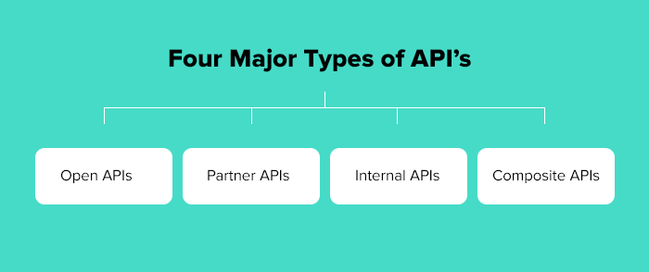

Slide 4

OPEN API:-
Open APIs, also known as external or public APIs, are available to developers and other users with minimal restrictions.
They may require registration, and use of an API key, or may be completely open.
They are intended for external users (developers at other companies, for example) to access data or services.
As an example, take a look at the provided by the UK government.
Any developer can access it, without even registering, allowing app builders to include governmental data on restaurant standards in their apps.

Slide 5
Partner API:-
Partner APIs fall somewhere in the middle of internal and external APIs.
They are APIs that are accessed by others outside the organization with exclusive permissions.
Usually, this special access is afforded to specific third-parties to facilitate a strategic business partnership.
A common use case of a partner API is when two organizations want to share data with each other — such as a county’s health department and a hospital within that county.
A partner API would be set up so each organization has access to the necessary data with the right set of credentials and permissions.

Slide 6
Internal API :-
An internal API is an interface that enables access to a company's backend information and application functionality for use by the organization's developers.
An internal (or private) API is intended only for use within the enterprise, to connect systems and data within the business. For example, an internal API may connect an organization's payroll and HR systems.
Internal APIs traditionally present weak security and authentication -- or none at all -- because the APIs are intended for internal use, and such security levels are assumed to be in place through other policies.

Slide 7
Composite APIs :-
Composite APIs generally combine two or more APIs to craft a sequence of related or interdependent operations.
Executes a series of REST API requests in a single call. user can use the output of one request as the input to a subsequent request. The response bodies and HTTP statuses of the requests are returned in a single response body. The entire series of requests counts as a single call toward your API limits.
The requests in a composite call are called subrequests. All subrequests are executed in the context of the same user. In a subrequest’s body, user specify a reference ID that maps to the subrequest’s response. user can then refer to the ID in the url or body fields of later subrequests by using a JavaScript-like reference notation.

Slide 8
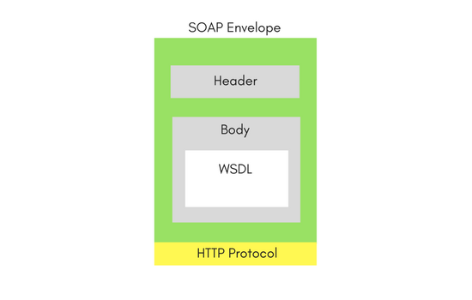
Types of Web Services: SOAP and REST
SOAP Web Services :-
SOAP is an XML-based protocol. The biggest advantage of using the SOAP Web Service is its own security. SOAP stands for Simple Object Access Protocol.
SOAP provides an envelope to send a web services messages over the Internet, using the HTTP protocol. The messages are generally in XML format.

Slide 9
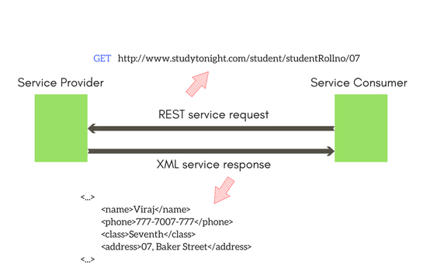
REST Web Services:-
The REST stands for Representational State Transfer. REST is not a set of standards or rules, rather it is a style of software architecture.
REST concerns more on the resources. REST locates the resources by using URL and it depends on the type of transport protocol.
transport protocol (with HTTP - GET, POST, PUT, DELETE,...)
For Example: in a RESTful architecture, this URL http://{serverAddress}/students/studentRollno/07

Slide 10


